Slide 1
IBM+VA Project Employment Fulfillment

Slide 2
save a life + build a good life enabling veterans to find fulfilling employment

Slide 3








Persona
James is a Veteran who separated 2 months ago. He had a 9-5 job through signing his papers, so he didn’t have time to attend trainings or put a lot of thought into his next step. Although he did create a short-term plan, he’s already dissatisfied and bored. He has applied for a few jobs and hasn’t heard back. He feels defeated and needs a nudge to determine out how to approach a longer-term plan for his career.
Empathy Map
Says
Thinks
Maybe I should’ve done that coding training that was offered when I was on the base…
I shouldn’t have spent all of my time partying with the battalion in those last few months…
I was a shitty student, so I don’t think I should go back to school…
“I couldn’t wait to take off the uniform, but now I kind of miss it.”
“I might go back to school.”
“I’ll figure it out.”
24 years old (Hispanic)
Army Vet (Enlisted)
Embarrassed that other guys in battalion seem to be doing better than me
Nervous I won’t get a better job
Angry that I’m not making as much money as I did in service
Confused by VA career resources
Irritated that my friends don’t get it
Spend time with high school friends
Watch TV / games
Occasionally apply for jobs, but don’t know people who can vouch for me
Drive for ride sharing companies at night
Girlfriend, no kids
High School Diploma
His short-term plan includes:
Does
Feels
Moving back to hometown
Taking time off
Driving for ride sharing service

Slide 4
GETTING OUT
STARTING UP
REINVENTING MYSELF
Journey Map
This journey map is adapted from the VACI Veteran Journey Map as informed by our research:
Research reports
Chaplain interviews (3)
Transition SME interview (1)
Chat-bot responses
steps | Understanding the process of separating | Finding something to do | Translating my military skills | Acquiring the appropriate education, new skills, and credentials | Finding the right job
doing | Continuing with daily routine (job) Putting TAP resources in a folder (not reading them) Putting together a short-term plan to get a signature | Vacation Doing odd jobs Applying for jobs Seeing friends | Two part-time jobs Applying for better jobs | Exploring options to build skills; web research mostly Talking to a few Veteran friends about ideas | Using some new tools to find jobs
thinking | I’ll figure it out later I can’t wait to take off this uniform I’ll miss my battalion | TAP made me think I could do anything, so why do I keep getting rejected? | I was responsible for 3 million $ worth of equipment, and now they want me to run the drive-through I am trained to kill people… that doesn’t translate | I wasn’t good at school so I went into the Army, and now I need to go back? There are so many options for training, but what do I pick? | What are my actual opportunities for something better? How do I find the right thing when I don’t know anyone? Maybe I should join the reserves
feeling | Excited Slightly nervous | Apathetic Discouraged Frustrated | Lost Defeated Unmotivated | Overwhelmed by options Confused about benefits | Curious about potential for something better Conflicted about options Discouraged with lack of network
VA existing benefits | Transition Assistance Program (TAP) | GI Bill Career Center Vocational Rehab & Employment | Skills Translator Career Center Resume Builder | GI Bill Vocational Rehab & Employment Educational & Vocational Counseling | Career Center Veterans Job Bank Resume Builder VA Employment

Slide 5
DRAFT Hills
Who
What
Wow
James, a recent veteran struggling to reinvent himself,
(1) can build a professional network
without sending a single email.
(2) can identify opportunities to build skills linked to a desired job without visiting a single website.
(3) can discover jobs that match his skills and interests
by answering less than 50 questions.
Sub-hills:
Sub-hills:
Identify why unhappy with existing job
Identify values + interests
Identify interest area skill gap
Match interest + skill gap with skills building opps.
Sub-hills:
Match existing skills to open jobs
Identify skills not included in ‘MOS’
Match skills + interests to open jobs

Slide 6
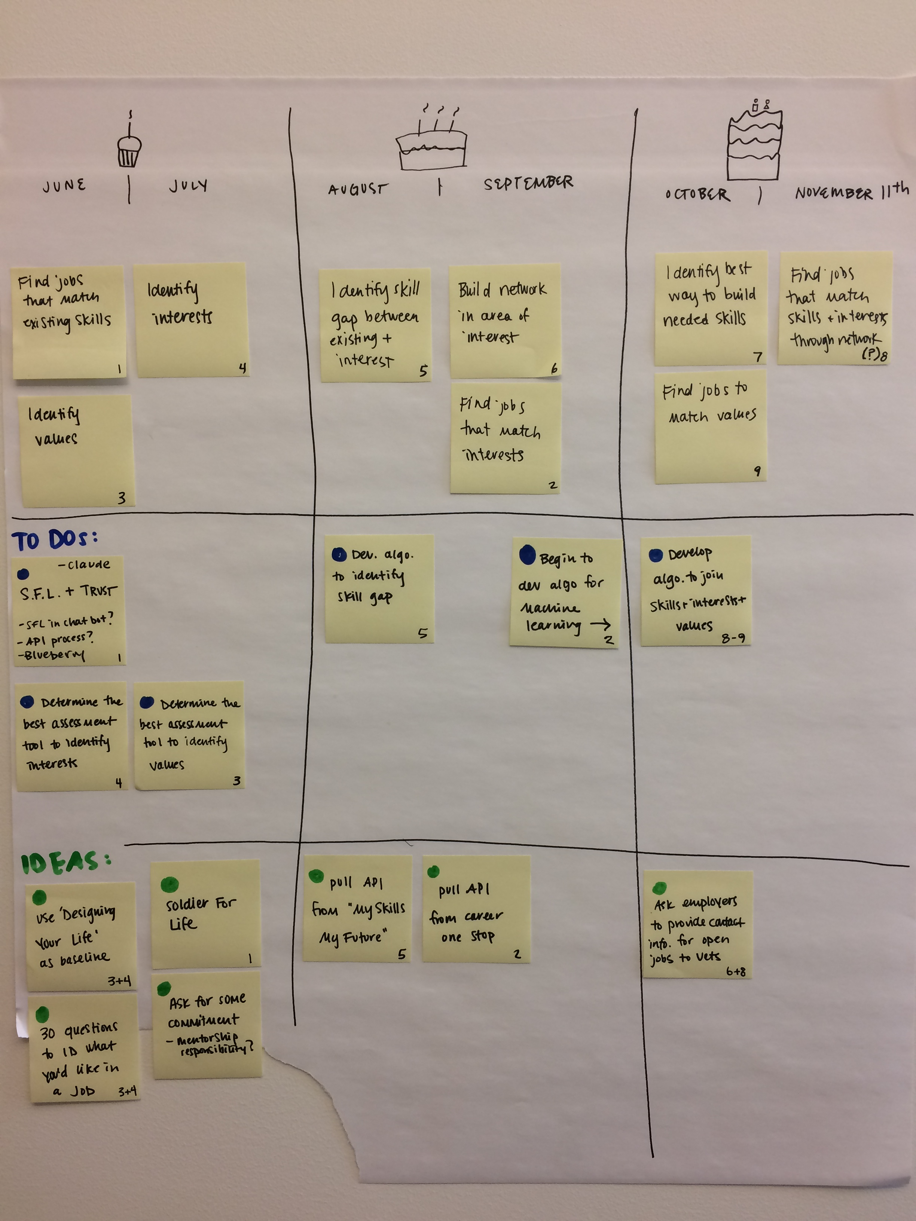
DRAFT Roadmap

Slide 7

STAGES
Inquire
Baseline
Hone
Refine & Suggest
Ask if we
Can help
Work
Environment
Location
Values
Personality
Explain
What we’ll
Ask
Interests
Constraints
Skills
Suggest
1st Set of Jobs

Slide 8
FULFILLMENT
Values
Interests
Personality
Constraints
Work
Environment
Skills
Location
Suggest
1st Set of Jobs
Watson Personality Insights | Soldier for Life | Watson Personality Insights | Soldier for Life | Chatbot (question) | Soldier for Life LinkedIn CEW @Georgetown (Center on Education and the Workforce) | Soldier for Life Chatbot (geolocation) | Soldier for Life LinkedIn

Slide 9
Feedback & Next Steps
Gather feedback & buy-in from group on proposed direction
Blueberry + SFL + Nest technical feasibility introduction for Pilot
Develop HLP / schedule
Collect specific feedback on initial questions

